Slide 1
EE 423 Capstone Presentation
By Team 6
Abigale Fernandez, Binh Phan, and Gabriel Rigney
Senior Level Electrical Engineering

Slide 2
Outline:
Project Goals
Drivers Considered
Driver Specifications
Construction
Testing
Performance
System Cost
Future Work

Slide 3
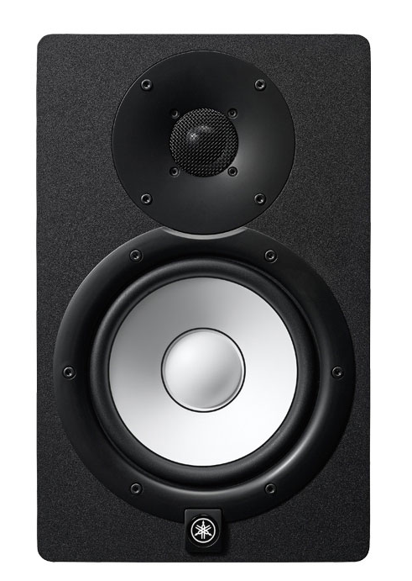
Project Goals:
Intended Design: Studio monitors
Inspiration: Yamaha HS7 studio monitors
Approximately 1 cubic foot in volume
Fairly high quality sound for affordable to mid-price range
Desired 40 Hz-20 kHz frequency
response, while staying well under our budget of $375
Notes:
Project goals:
Market:
Music production monitors
Intended use:
Near-field studio monitors
Speakers directed to those who want are producing in relatively small studios
Performance target
Size and Cost
H: 16”
W: 9.5”
L: 11”
.97 cubic feet = 27.4 liters

Slide 4
Project Focus:
Vented box design chosen to keep volume size to
desired volume of 1 cubic foot
Crossover network to keep response as flat as possible
with a crossover frequency around 1.6 kHz
Vented box, 16” height, 9.5” width, 11” length
Total External Volume: .97 cubic ft, 27.4 liters
Total Internal Volume: .69 cubic ft, 19.4 liters
Budget: $137.13 per box ($138.52 under budget!)
Project Results:
Notes:
Focus:
Designs Considered
Drivers Chosen
https://www.parts-express.com/pyramid-wx65x-6-1-2-white-poly-woofer--290-270
https://www.parts-express.com/dayton-audio-dc28f-8-1-1-8-silk-dome-tweeter--275-070

Slide 5
Drivers Considered
Drivers chosen based on recommended design volume.
Two Goldwood woofers considered, (6.5” & 8” diameters)
Ultimately, we decided on a 6.5” Pyramid woofer as it
provided the best quality compared to its cost ($19.50)
Various Dayton tweeters considered. Ultimately, a 1⅛” silk
dome tweeter was chosen, again because of the value of its performance compared to cost ($19.75)

Slide 6
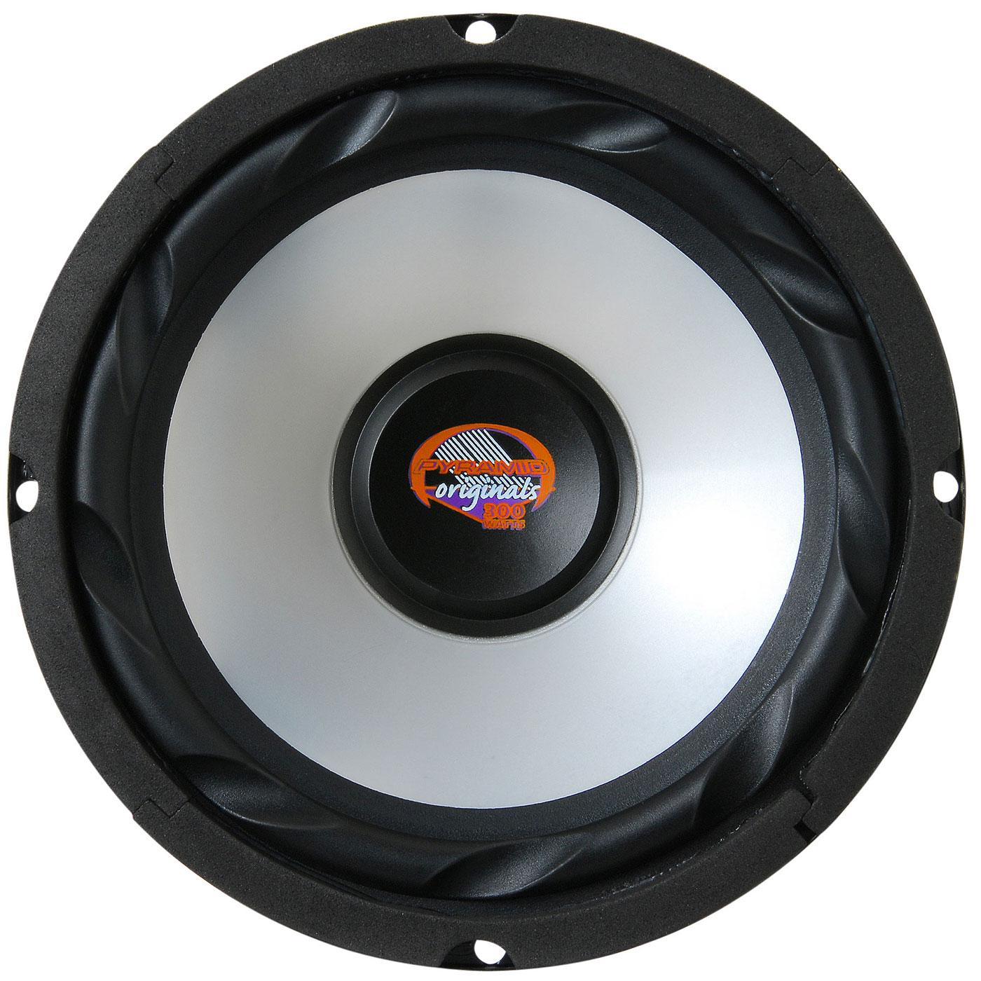
Pyramid WX65X
6-½“ White Poly Woofer
6.5” Pyramid woofer provided great quality compared to its relatively low cost of $19.50

Slide 7
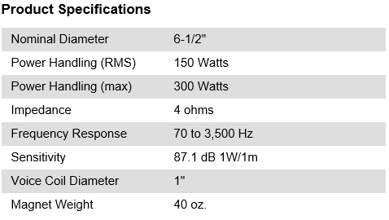
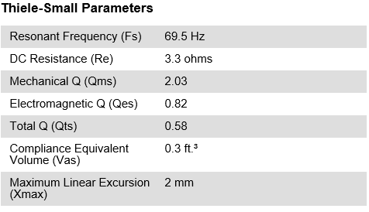
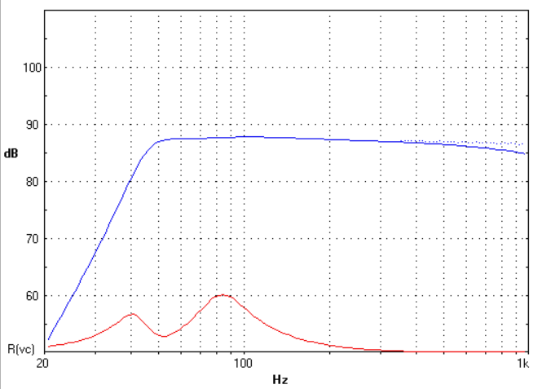
Woofer Specifications:
Pyramid surprisingly offers no response curves for their products.
These curves were obtained using Boxwrx. We felt confident enough to proceed with this woofer.

Slide 8
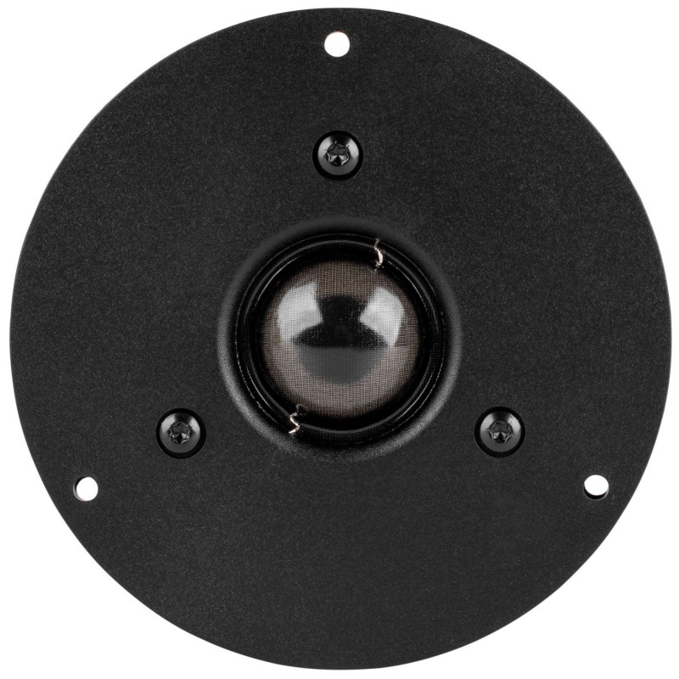
Dayton Audio DC28F-8
1-⅛” Silk Dome Tweeter
Highly rated tweeter of a small diameter

Slide 9
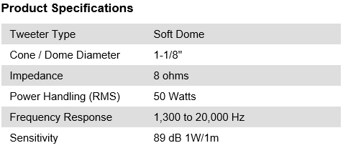
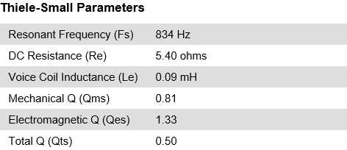
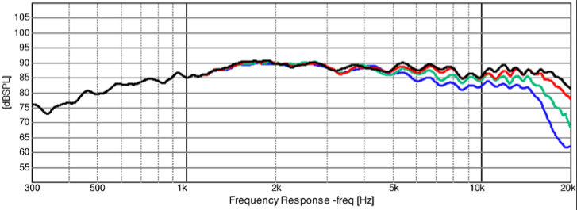
Tweeter Specifications:
Tweeter was rated very highly and, upon inspection, seemed like it would crossover well with the woofer. This actually ended up being more difficult than anticipated.

Slide 10
Construction
Port tube was 2.5” in diameter, which required 7.1” length to tune to 50 Hz.
Notes:
Show pictures of raw components,
partially completed box, and crossover
network. Describe construction techniques.
Use only a few slides.

Slide 11
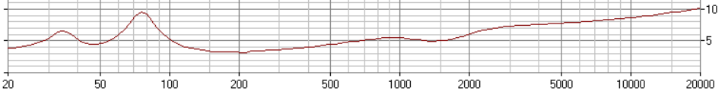
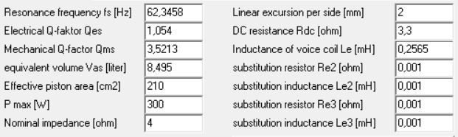
Testing - Woofer
Notes:
Show measured woofer response and impedance
curves. Include a table of basic Thiele-Small
parameters with published vs. measured values.

Slide 12
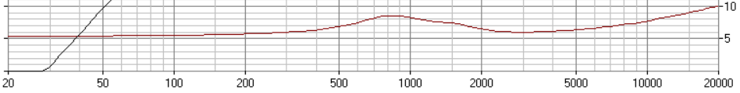
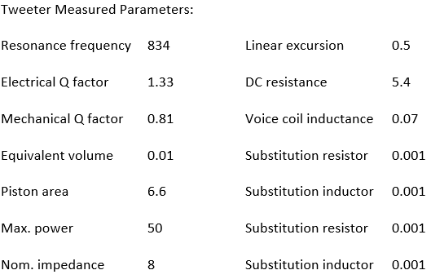
Testing - Tweeter
Notes:
Show measured woofer response and impedance
curves. Include a table of basic Thiele-Small
parameters with published vs. measured values.

Slide 13
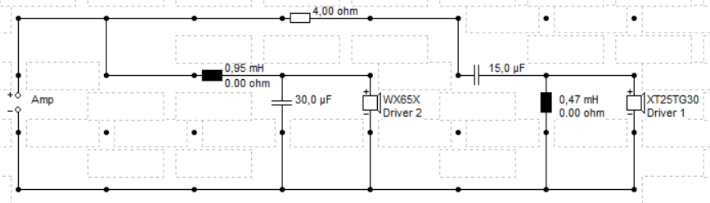
Crossover Network Design
Crossover frequency tuned to 1600 Hz with the help of the Boxsim program. The woofer and tweeter were having phase issues regardless of polarity, so some significant tweaking was needed. With professor’s help, we achieved
a relatively flat response.
Notes:
Schematic circuit of final design with
component values.
Measured electrical response of hipass and
lopass sections with loudspeakers connected.
Describe any special features.

Slide 14
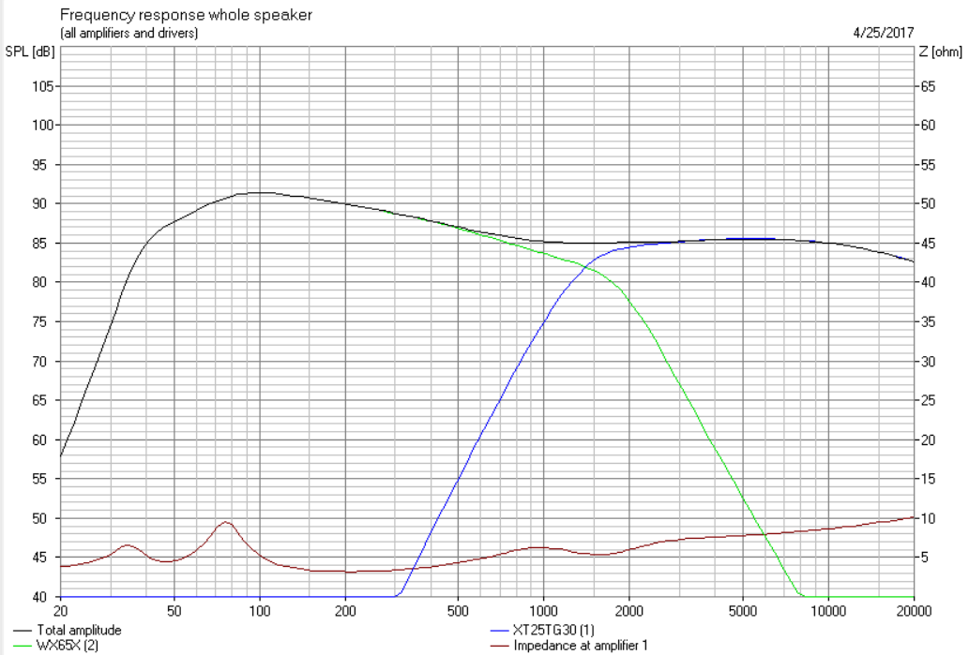
Simulated System Performance
Notes:
Boxwrx plot of response, excursion, and impedance.
Box dimensions, internal volume, and vent dimensions.
Front panel layout with important dimensions.

Slide 15
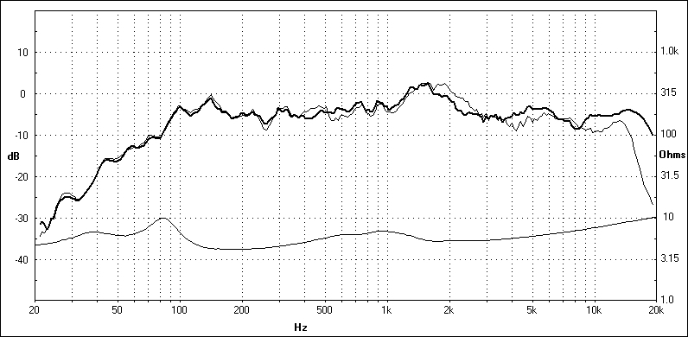
System Performance
Notes:
Show plot of complete system response and impedance.
Show off-axis response if available.
Show photo of final system.

Slide 16
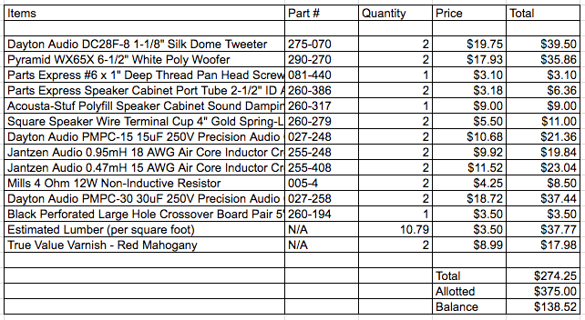
System Cost
Notes:
Project expenses per box -
Condensed list of actual expenditures
and estimate of lumber cost.

Slide 17
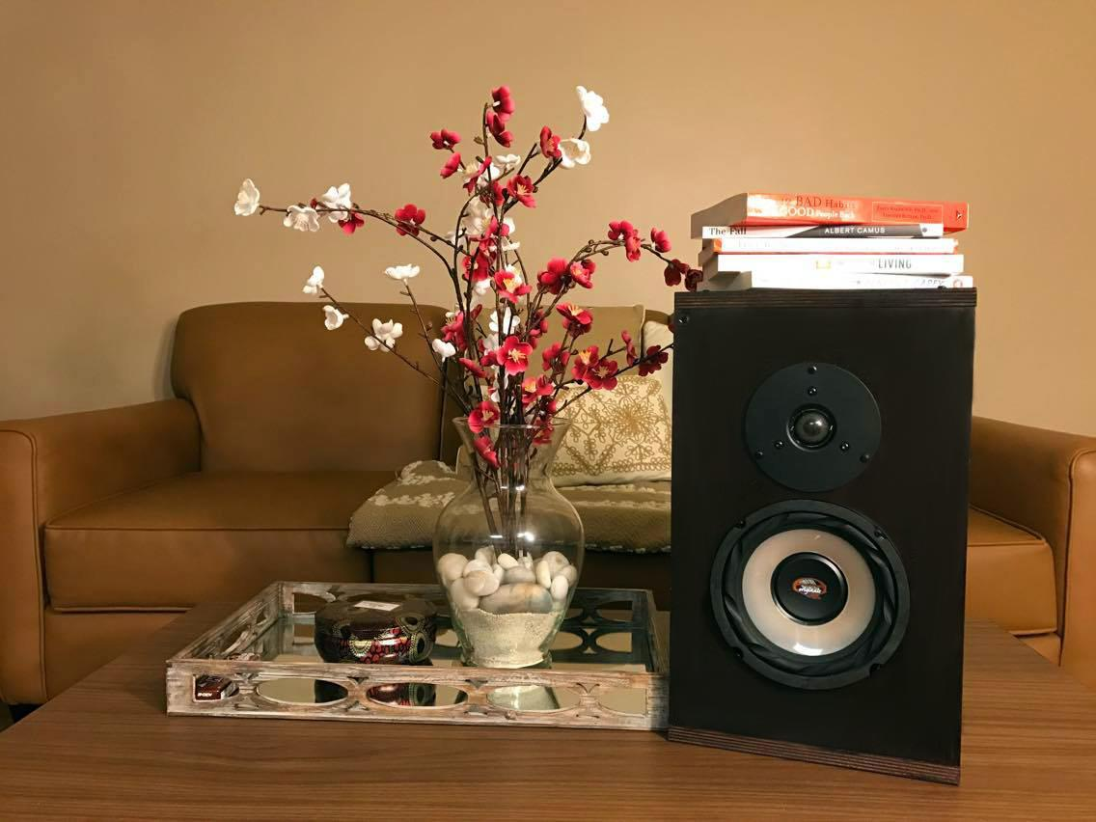

Slide 18
Future Work:
With more money, we would have purchased a higher quality woofer, since we ended up missing more frequencies than our simulation led us to believe.
With more time, we would have built a subwoofer, and made amplifiers built in the speakers.
For an actual production prototype, we would source our crossover components from another vendor, as these components consumed half of our budget.
Notes:
What we do different with more times?
We would have made subwoofer because our low frequencies weren’t as great as we predicted it to be.
What would we do differently with more money?
We would probably picked a better woofer
We would definitely have made a subwoofer
What would we do differently for an actual production prototype?
We would

